Slide 1
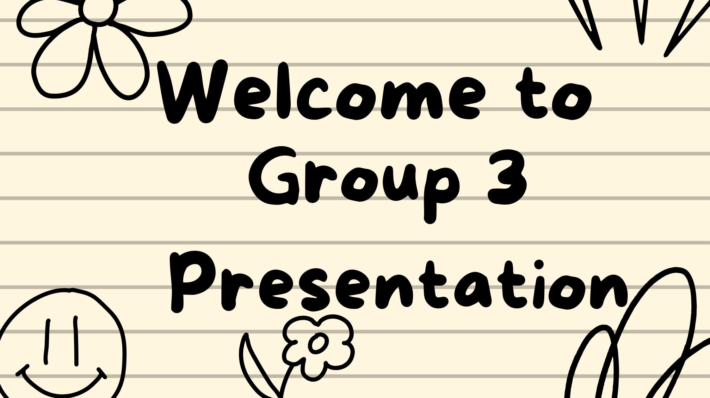

Slide 2
Who is our client? And
what does our client want
CLIENTS NAME: LIAM DANIELS
What does he want:
HE WOULD LIKE TO HAVE A WEB PAGE AND A MOBILE APP
We wanted to be at his service and he was looking to create an easy and usable application for his clients
REQUESTS FROM POTENTIAL CUSTOMERS AS WELL AS PROVIBE
QUATATIONS FOR ADVENTURE EXPERIENCE AND ACTIVITIES

Slide 3
Introduction
What is Adventure Escape SA?
Adventure Escape SA is a name for the website and mobile application concept designed to help users discover and explore exciting adventure and outdoor activities in South Africa.
The project focuses on making it easier for users to:
Discover adventure destinations
Explore different activities
View information about destinations
Plan their adventures
Find exciting experiences in one place

Slide 4
Why We Chose Adventure Escape SA
Why did we choose this concept?
We were given different scenarios to
Choose from and the one that won our
Mind was the adventure escape sa one
Liam was interested in making his
Customers work easier, less complicated
And less stressful
- We chose Adventure Escape SA because South Africa has many beautiful destinations and exciting outdoor activities, but people may not always know where to find information about them.
- Our idea was inspired by the need for a platform that brings different adventure experiences together in one place.
- Our main reasons were:
- People enjoy travelling and exploring new places.
- We wanted to create something exciting and interactive.
- The concept gives us an opportunity to combine website and mobile app development.
- It allows us to solve a realworld problem through technology.
WHY ADVENTURE ESCAPE?

Slide 5
Our Vision
To create an easy to use digital platform where people can discover, explore and plan exciting adventures across South Africa.
Our Mission
To connect users with memorable outdoor experiences while providing useful information about destinations and activities.
And to make their exploring and adventure life easier for them.

Slide 6
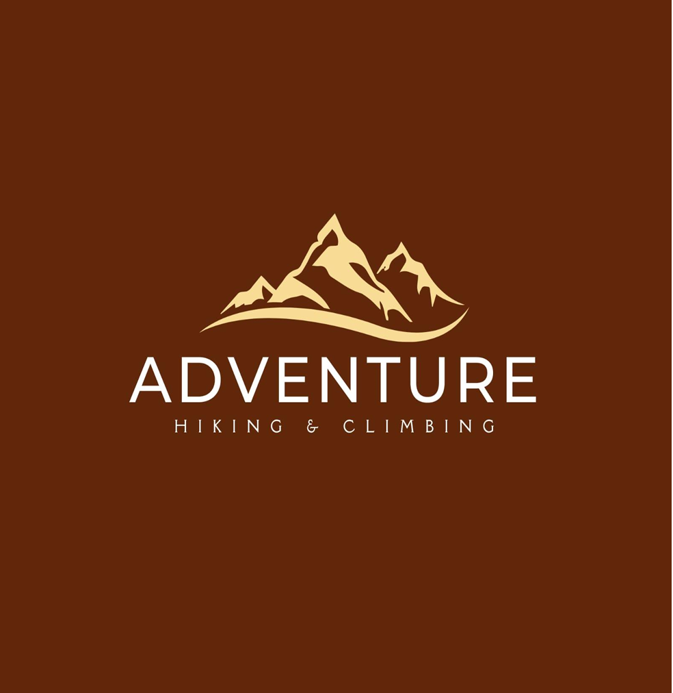
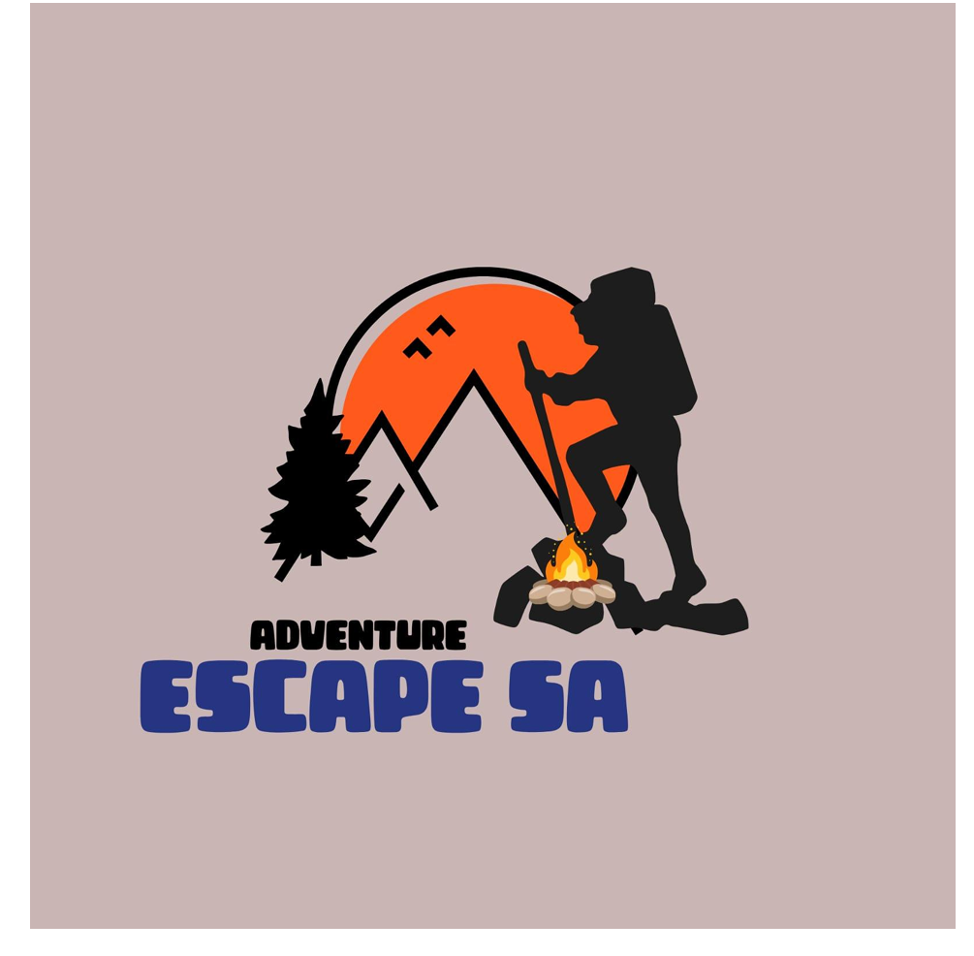
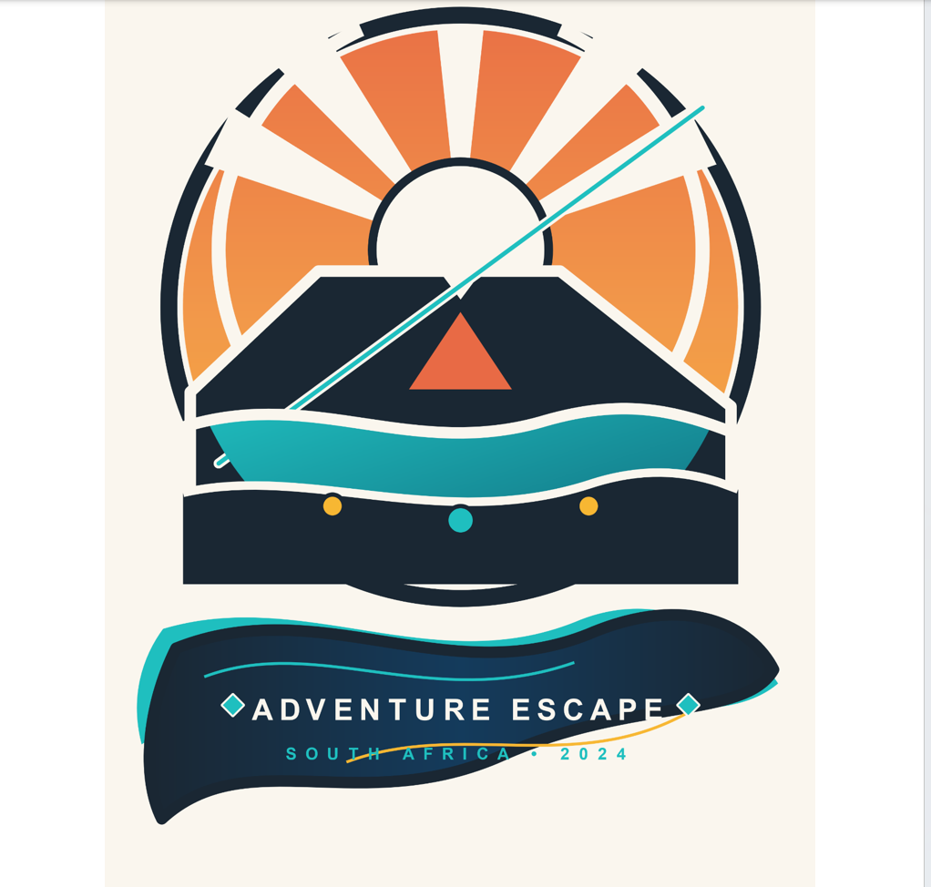
All the 3 logo’s

Slide 7
Our Brand Identity
Our branding represents the adventurous and natural experience that Adventure Escape SA provides.
WHY WE CHOSE THE LOGO
As a group we chose this logo, because the hiker, mountains, trees and campfire instantly shows adventure, hiking and camping without words, while the orange sun represents energy and excitement, the black colour gives strength and boldness for mobile visibility and the blue text adds trust for families, schools and corporate clients, with the earthly background tying is all to nature which fits adventure Escape SA’s brand perfectly
The logo we have chose

Slide 8
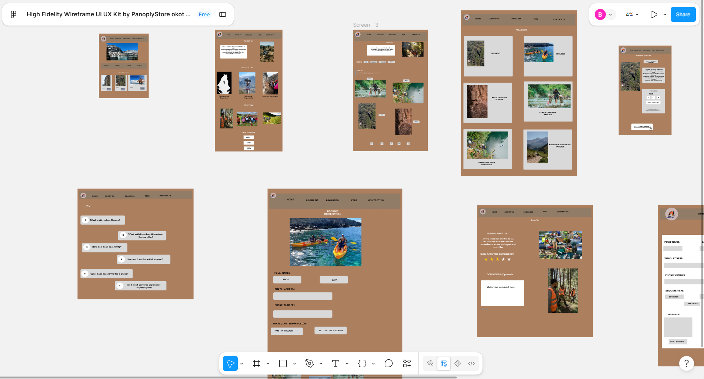
WIREFRAMES

Slide 9
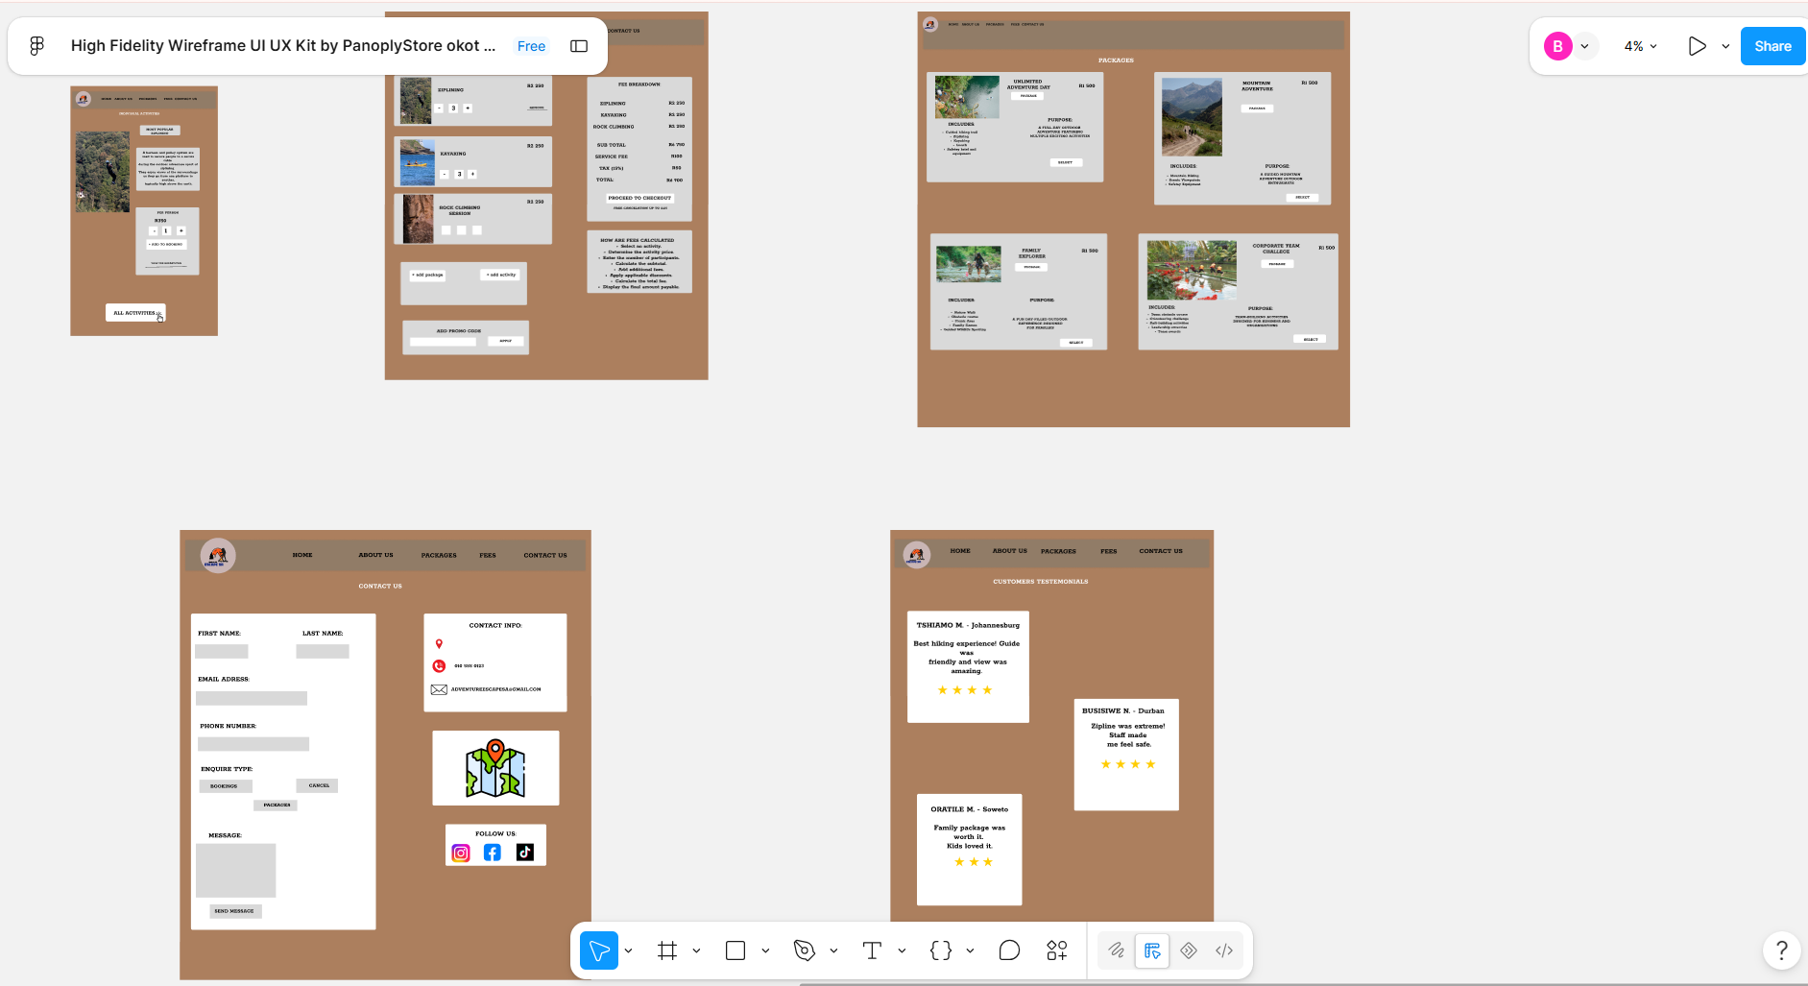
WIREFRAMES

Slide 10
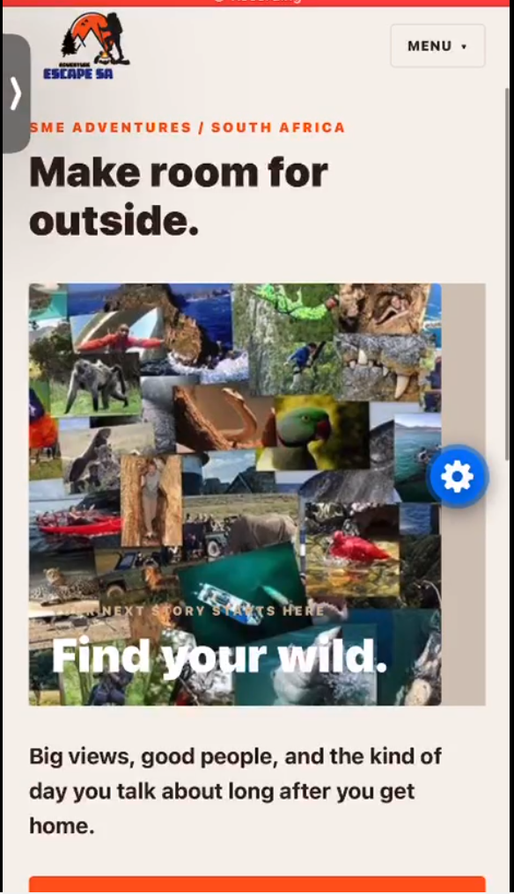
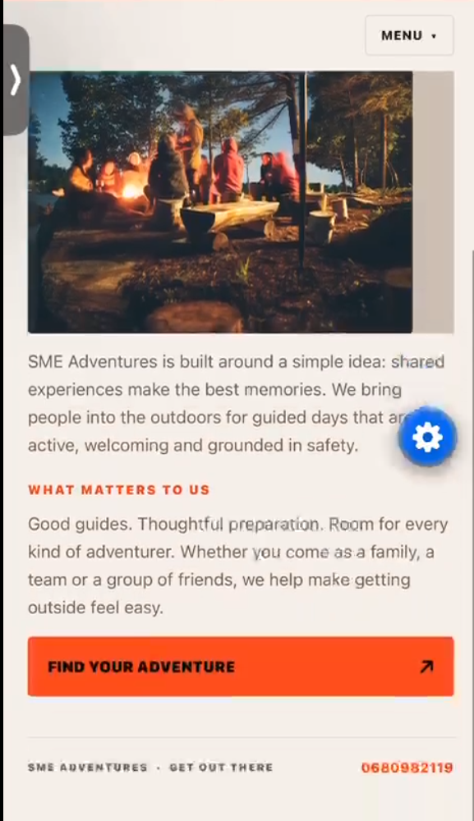
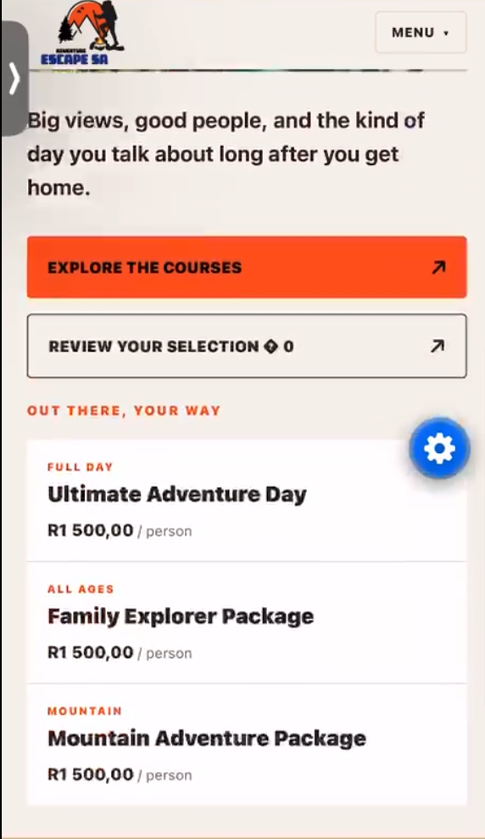
WIREFRAMES

Slide 11
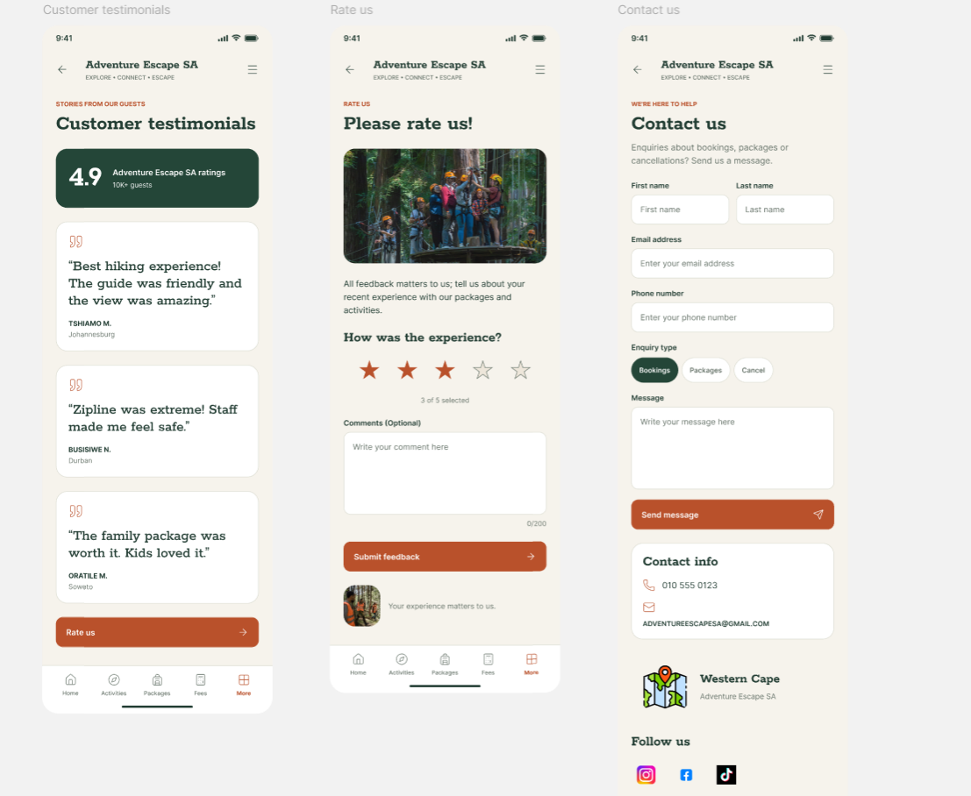
WIREFRAMES

